Slide 2
QIZ Background

Slide 3
Definition
QIZ are industrial parks housing manufacturing operations in Jordan and Egypt.
They are a special FTA established in collaboration with neighboring Israel to take advantage of the free trade agreements between the United States and Israel.
Under the trade agreements goods produced in QIZ-notified areas can directly access US markets without tariff or quota restrictions, subject to certain conditions.
To qualify, goods produced in these zones must contain a small portion of Israeli input. In addition, a minimum 35% value to the goods must be added to the finished product

Slide 4
HISTORY Reinforcing peace in the Middle East through regional economic partnerships
12/1996
US issued the decree 6955 authorizing duty-free entry into the US for industrial products originating in Egypt and manufactured jointly with Israel, in compliance with the international rules of origin.
1999, Jordan signed a QIZ protocol
14/12/2004
Egypt signed the QIZ Protocol with the US and Israel. The Protocol allows for duty-free entry into the US for products manufactured by qualified companies operating within designated geographic locations in Egypt which satisfy the currently agreed upon Israeli content of 11.7%.

Slide 5
QIZ Overview
Protocols between Egypt and Israel
Section 7 of the U.S. – Israel Free Trade Area Implementation Act Presidential Proclamation 6955
1-Increase employment opportunities in
2-Stimulate participating economies
3-Promote collaboration between Egypt and Israel

Slide 6
QIZ General information

Slide 7
QIZ Requirements
US Requirements
The article is a “new and different article of commerce” produced in QIZ
It is “imported directly” into the United States
The sum of the cost or value and the direct cost of processing in Egyptian QIZ and Israel is not less than 35%of the article’s US entered value
Up to 15% of the article’s value may be U.S inputs that contribute to the total 35% requirement.
Egypt – Israel Protocol Requirements
The Israeli components must contribute 10.5%
Egyptian manufacturer in the QIZ must contribute one third (11.7%) of the 35% content requirement
The remainder of the 35% can come from West Bank, Gaza Strip, Israel, the QIZ, or as mentioned, the U.S.

Slide 8
Participating Factories
QIZ joint committee, comprises of representatives from Egypt and Israel. Provide lists of QIZ companies whose products are eligible for QIZ treatment
The Accurate factory should get a QIZ certificate issued from the Joint Committee to start work
Current lists http://www.qizegypt.gov.eg/images/attachment.ashx.pdf

Slide 9
QIZ Map

Slide 10
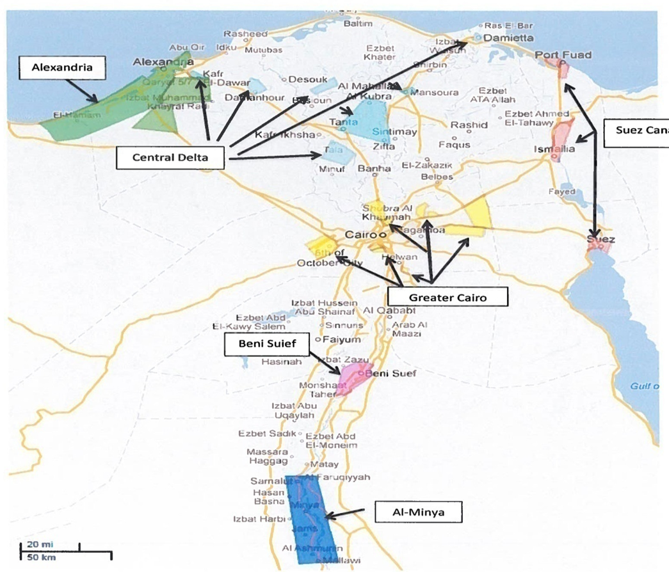
Geographic Coverage Area
Greater Cairo
Giza Shubra Al Kheima, Nasr City, 10th Ramadan City 15th May City , Badr City | 6th October City , Obour City Kalyoub City and Industrial Area in Gesr El Suez.
Alexandria
Middle Delta
Gharbia Dakahlya Kafr El-sheikh Kafr El-Dawar City | Monofia Damietta Demanhour City
Suez Canal Area
Port Said Ismailia Suez
Upper Egypt
Al Minya Beni suef

Slide 11
QIZ Companies Profile

Slide 12
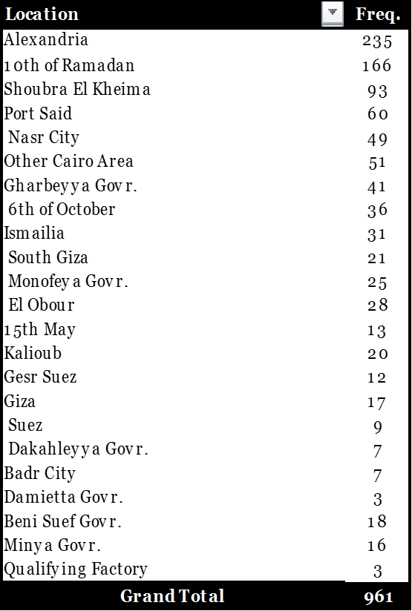
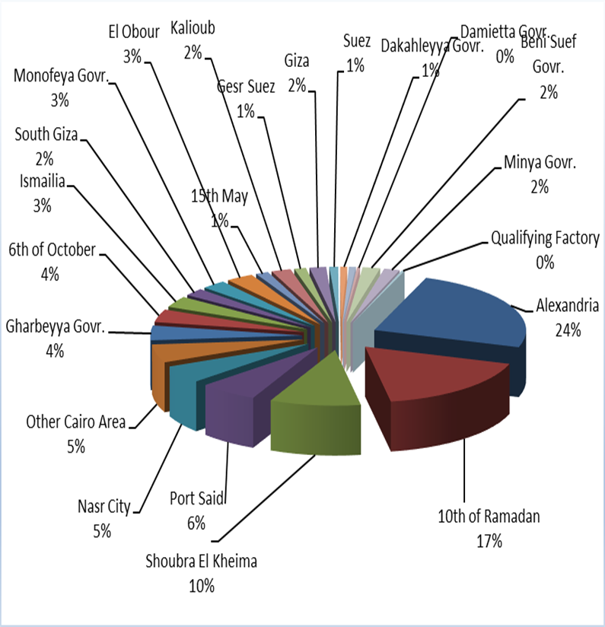
Distribution of listed companies by location * till end of Feb, 2017
Notes:
Change table font – Number is not readable

Slide 13
Distribution of listed companies by labor (Total no. of workers) * till end of Feb, 2017
Notes:
Change table font – Number is not readable
Check validity

Slide 14
Distribution of listed companies by Capital & Investment (EGP) * till end of Feb, 2017
Distribution of listed companies by capital (EGP)
Distribution of listed companies by investments (EGP)
Notes:
July, 2015

Slide 15
QIZ Exports & Imports

Slide 16
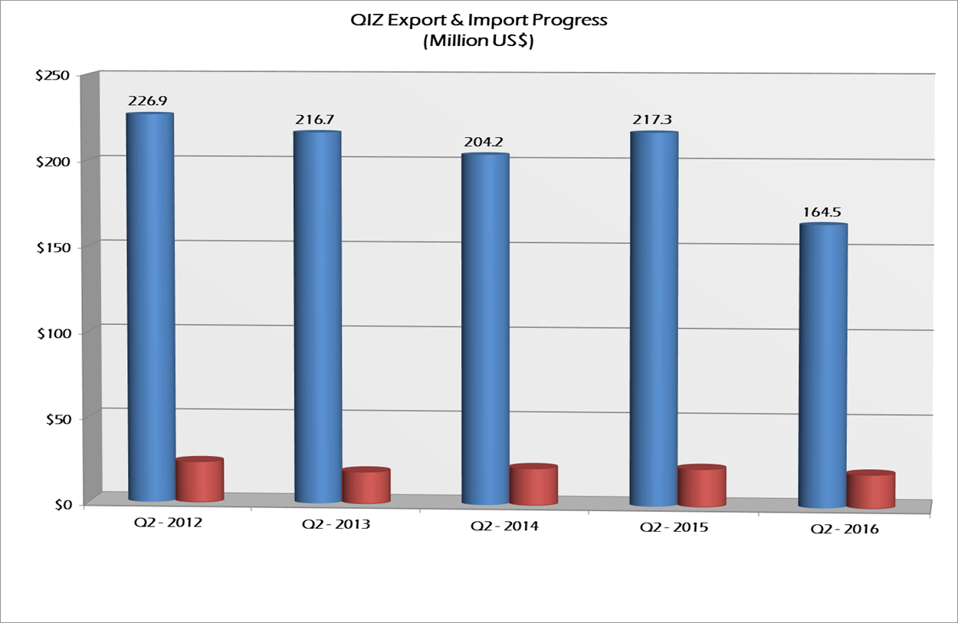
Export & Import Progress by Quarter * From 2012 till 2nd Quarter 2016

Slide 17
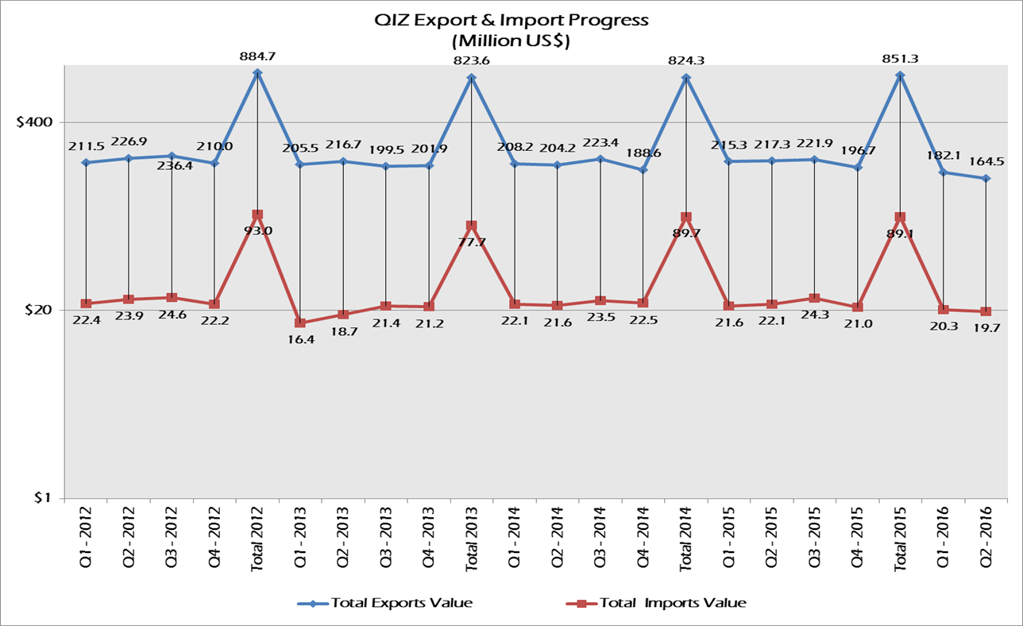
Export & Import Progress by Year * till end of 2nd Quarter 2016

Slide 18
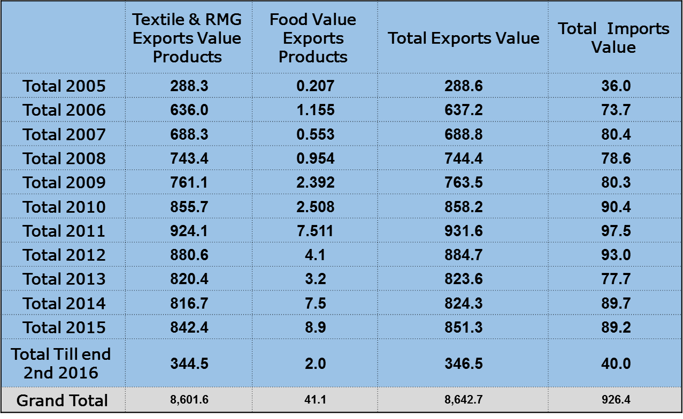
QIZ Statistics
Exports and Imports Value From 22/2/2005 Until 30/06/2016 *(value in Million US$)
Notes:
Need update

Slide 19
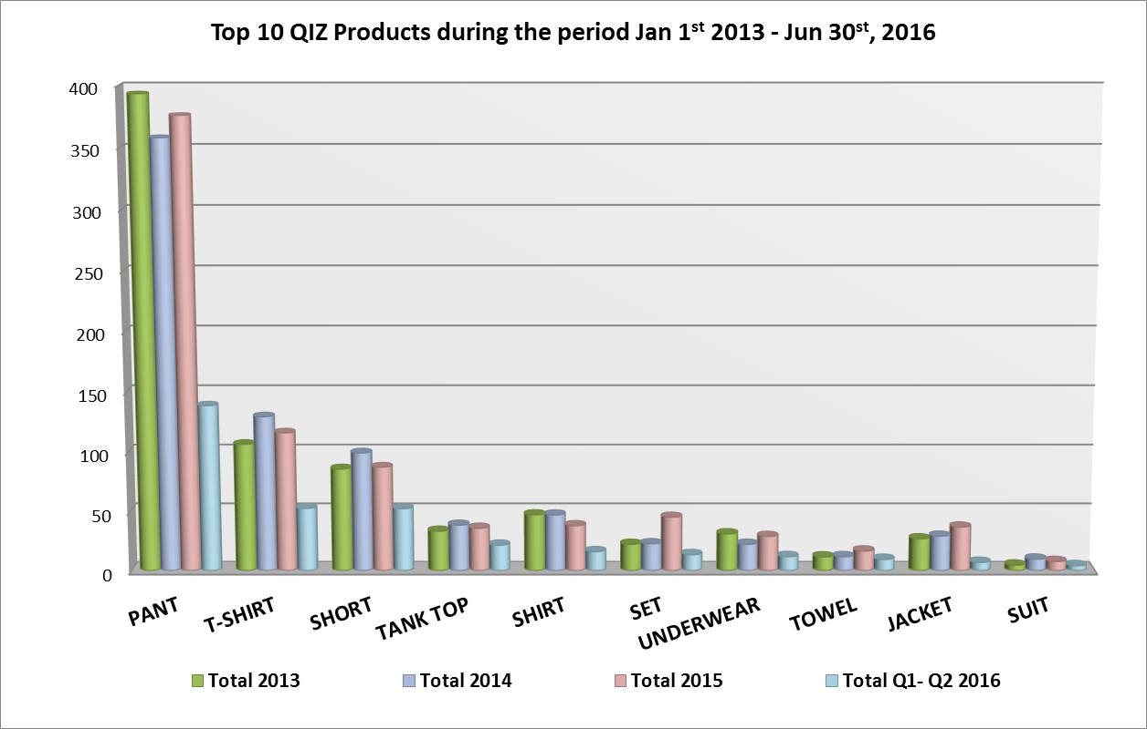
QIZ Exports by Products
Notes:
Dec 31st, 2015

Slide 20
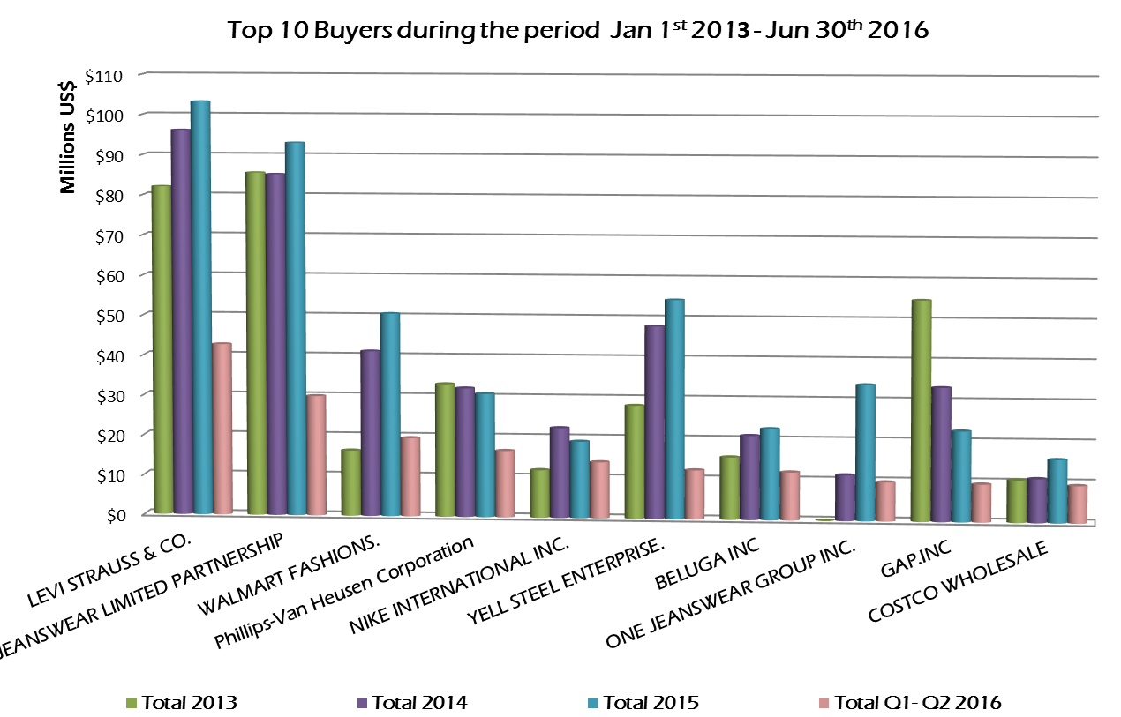
Top 10 US Buyers …
Notes:
Dec 31st, 2015

Slide 21
10.5% Israeli Content Imports

Slide 22
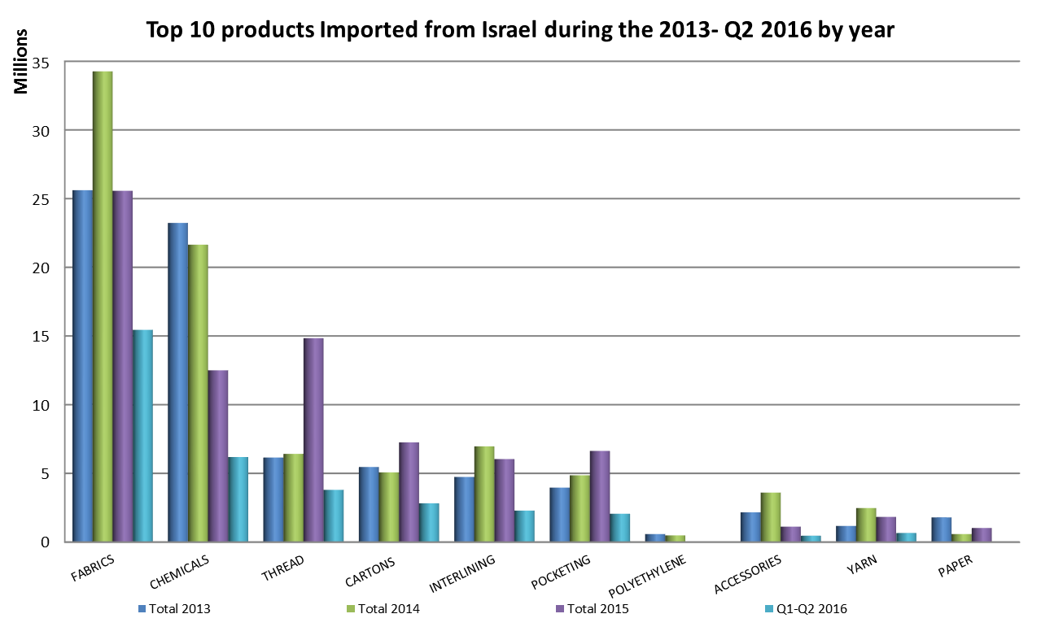
Imports from Israel by Products

Slide 23
Future of the QIZ Protocol

Slide 24
New strategy of QIZ Unit
Horizontal
Adding
New companies in Upper Egypt
Joining
New Areas In Delta and other northern Governorates
Sectoral
Diversifying
the benefiting Industrial sectors from the QIZ by Add food sector & Leather sector
Expanding the QIZ Protocol

Slide 25
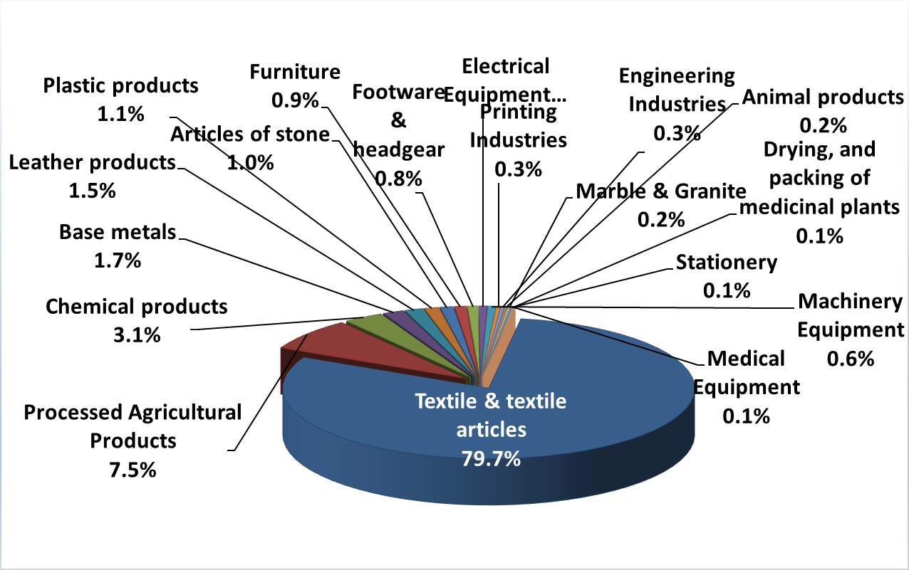
Distribution of listed companies by sector

Slide 26
Thank you …
QIZ Unit
Ministry of Trade and Industry
2 Latin America Street Garden City, Cairo, Egypt
Tel. | 202 792 1202, 2794 8703 (direct) 27921201, 27921177, 7920791
Fax | 202 794 8025
Website | www.QIZEgypt.gov.eg
Enquiries related to registration and QIZ qualification procedures | procedures@qizegypt.gov.eg
Enquiries related to QIZ customers, suppliers, and other service/product providers | matchmaking@qizegypt.gov.eg
Enquiries related to investment opportunities in QIZ areas | investing@qizegypt.gov.eg
General enquiries | info@qizegypt.gov.eg

